Slide 1
Translucent Food Ecommerce website
Team Details:
Janvi Sethi-2210990431
Jasneet Singh-2210990452
Jasleen -2210990447
Kunal-22109905
Faculty Coordinator: Dr. Baljit Kaur
Mr. Vikas Patel
Chitkara University Institute of Engineering and Technology,
Chitkara University, Punjab

Slide 2
Table of Contents
Introduction
Problem Statement
Understanding the User Experience
Key Features
Technical Details
Project Highlights
Target Audience
Project goals
Conclusion
References/Links used

Slide 3
Introduction
In this project our primary objective is to develop a cutting-edge food delivery application using the powerful React.js framework. Our aim is to revolutionize the way users interact with food delivery services, providing them with an unparalleled experience that seamlessly integrates convenience, choice, and efficiency.

Slide 4
Problem Statement
In today's fast-paced world, consumers increasingly rely on food delivery services to satisfy their culinary cravings and convenience needs. However, existing food delivery platforms often fail to provide a seamless and personalized experience that caters to the diverse preferences of modern users. There is a clear opportunity to develop a sophisticated food delivery application that not only streamlines the ordering process but also enhances user engagement and satisfaction.

Slide 5
Understanding the User Experience:
At the heart of our development process lies a deep understanding of user needs and preferences. We recognize that today's consumers crave convenience and variety, and our app will cater to these desires by offering a wide selection of cuisines and restaurant options, all accessible at their fingertips.

Slide 6
Key Features
Intuitive Ordering Interface: Users can easily browse restaurant menus, customize orders, and place requests with simplicity.
Personalized Recommendations: Advanced algorithms offer tailored suggestions based on user preferences and order history.
Real-Time Order Tracking: Users receive updates on order status from confirmation to delivery, ensuring transparency.
Secure Payment Integration: Multiple payment options with robust security measures for safe transactions.
Rating and Review System: Users can provide feedback on restaurants and delivery experiences, enhancing trust.
Accessibility and Inclusivity: Features like screen reader compatibility and adjustable text sizes ensure accessibility for all users.

Slide 7
Tech Stack:
HTML, CSS, and JavaScript: Foundational technologies for structuring, styling, and adding interactivity to the user interface, ensuring a seamless and visually appealing experience.
React.js: Utilizing React.js for frontend development will enable the creation of dynamic and responsive user interfaces, facilitating efficient management of components and state.
APIs: External APIs can be integrated for additional functionalities such as geolocation services, payment gateways, and accessing restaurant databases, enhancing the app's features and capabilities.

Slide 8
Project Highlights
Interactive User Experience: Utilizing React.js for an engaging user interface, enabling seamless browsing and ordering.
Stylish Design: Employing CSS for an attractive and visually appealing layout.
Structured HTML: Organizing the page layout for easy navigation and accessibility.
Search with API Integration: Implementing JavaScript for a powerful search feature, fetching real-time data for accurate results.
Personalized Recommendations: Providing tailored suggestions based on user preferences and history.
Real-Time Order Tracking: Enabling users to track orders from confirmation to delivery for transparency.
Secure Payment Integration: Integrating secure payment gateways for smooth transactions.
Accessibility: Ensuring accessibility features for all users' convenience and inclusivity.

Slide 9
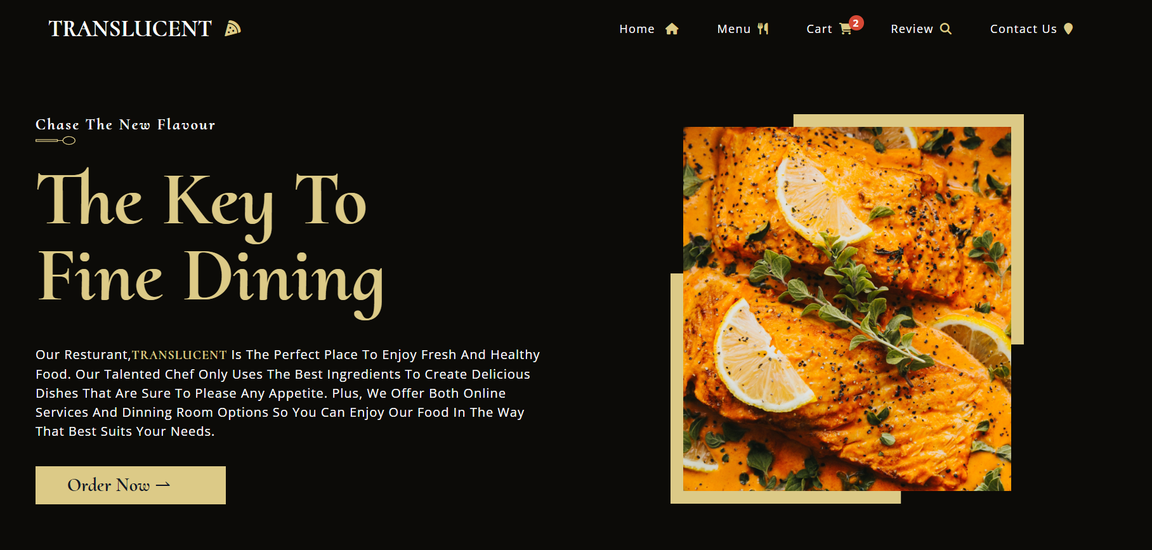

Slide 10
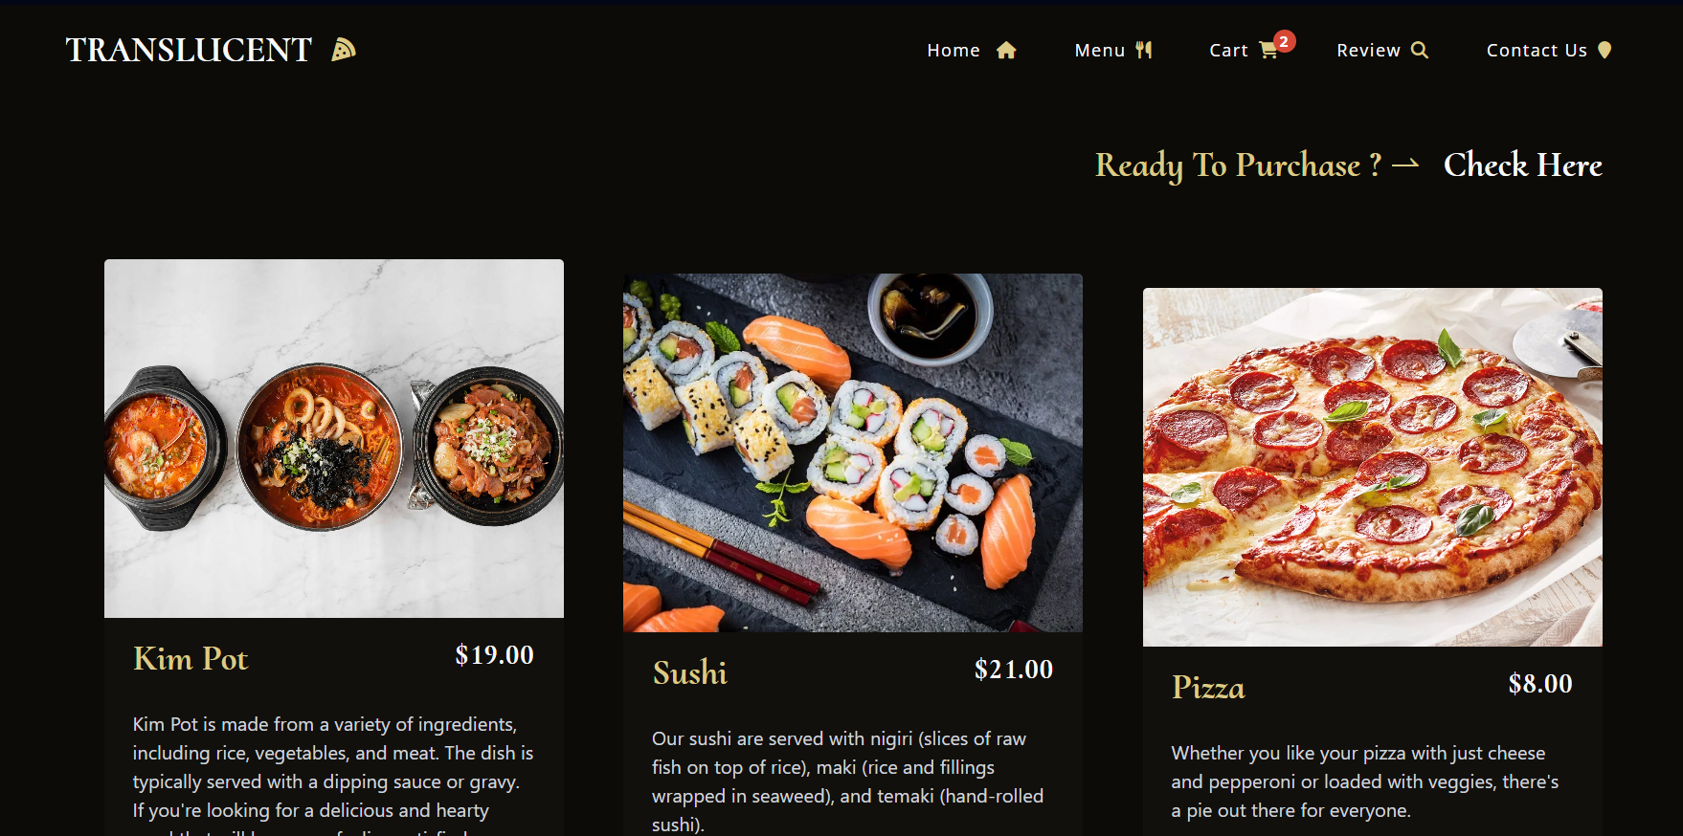
Menu page

Slide 11
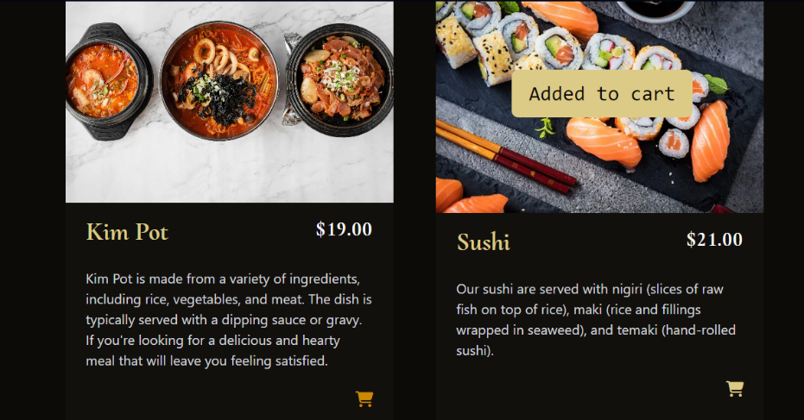
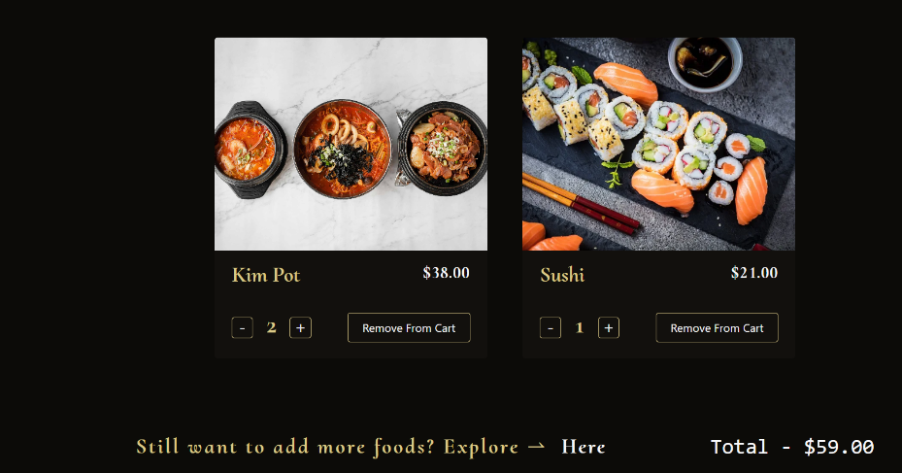
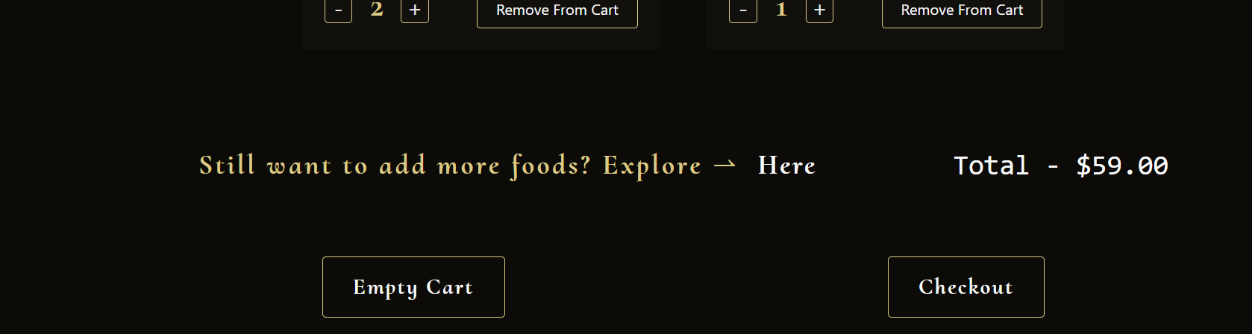
Add to cart page

Slide 12
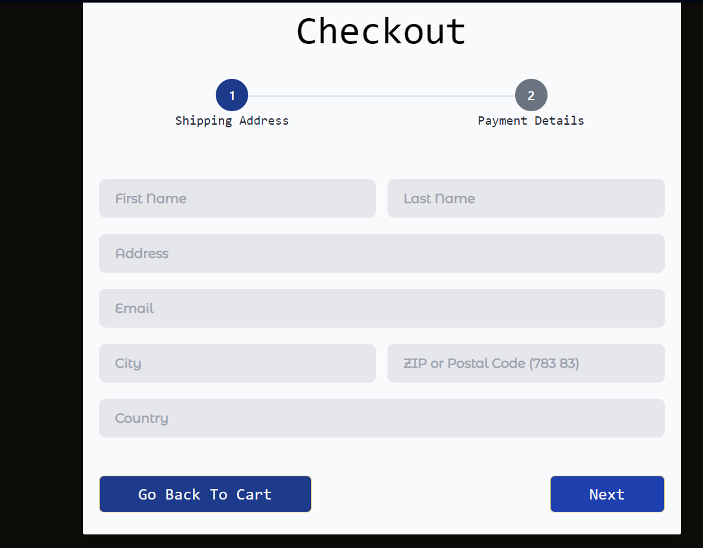
Check out page

Slide 13
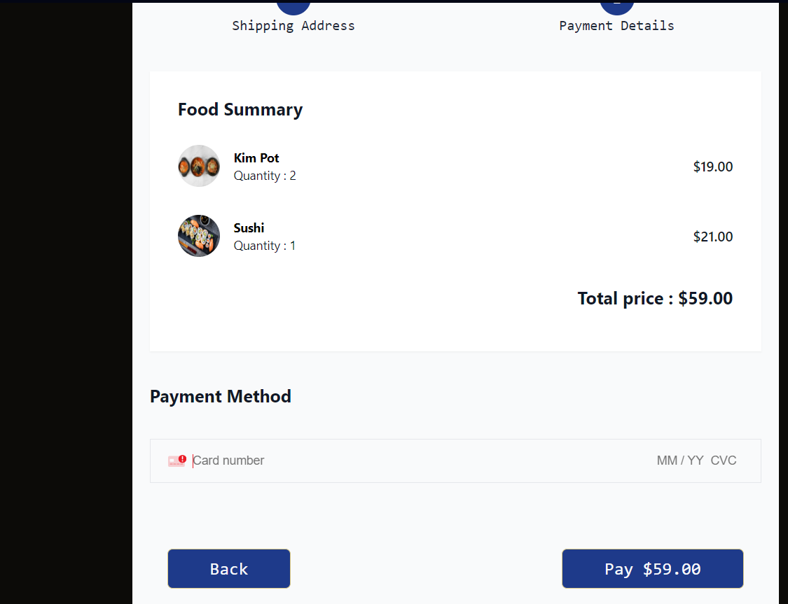

Slide 14
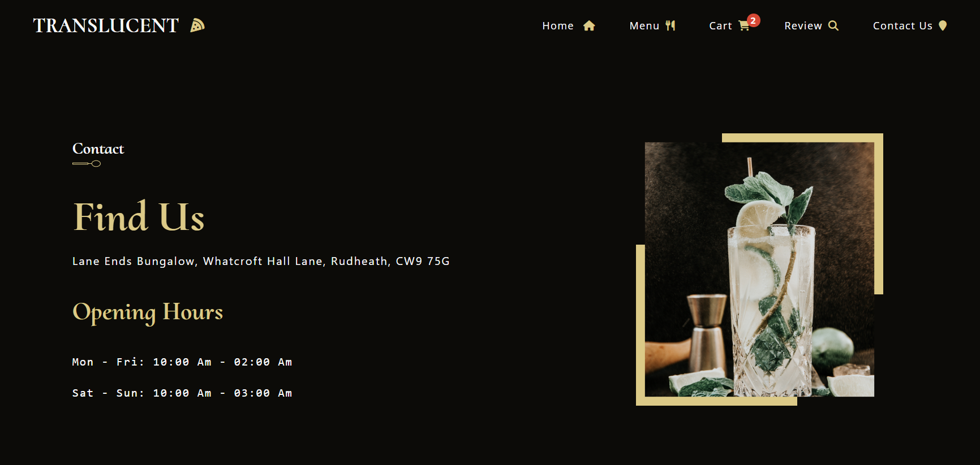
Contact us page

Slide 15
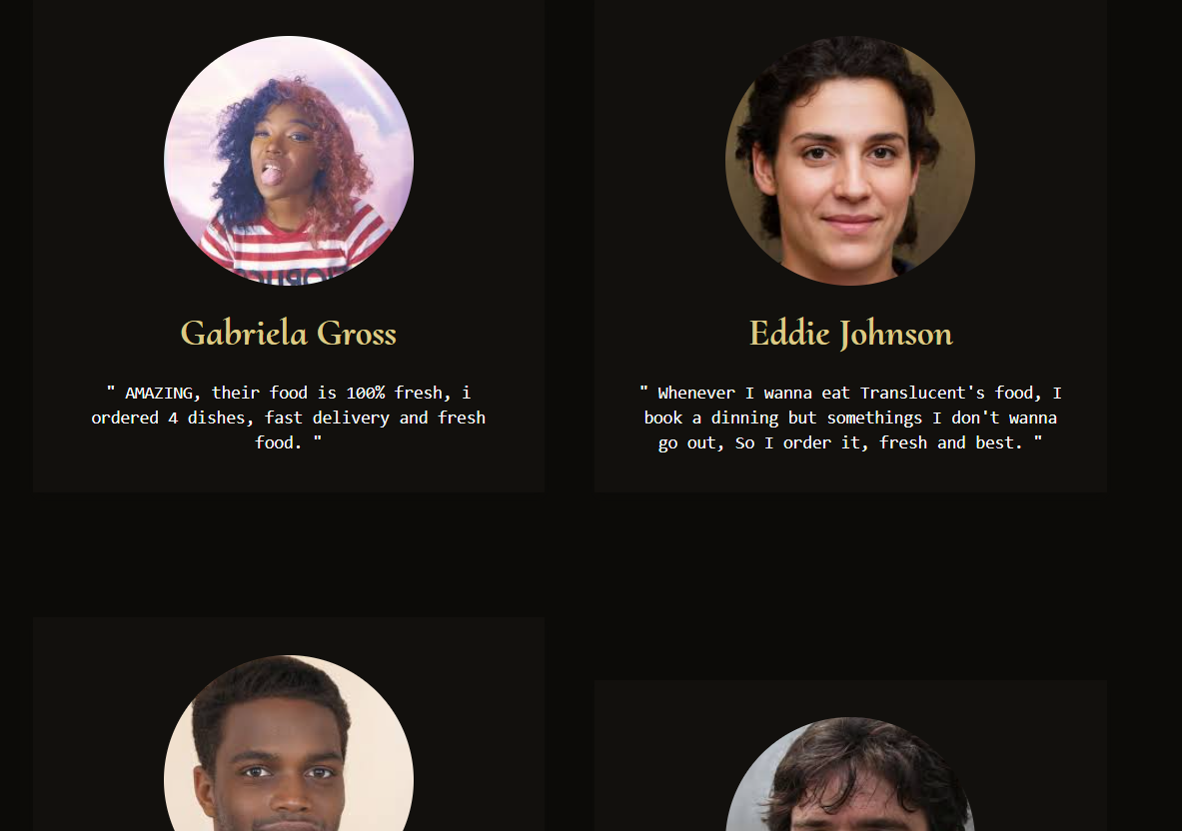
Review page

Slide 16
Target Audience:
The target audience for translucent-food includes urban dwellers, office workers, busy families, and anyone who values convenience and quality in their dining choices. Whether it's a quick lunch at work, a cozy dinner at home, or a special occasion celebration, translucent-food will be there to fulfill their cravings and culinary desires.

Slide 17
Project Goals:
Our goal with translucent-food is to create a market-leading food delivery application that sets new standards for convenience, reliability, and user satisfaction. By combining innovative technology with a user-centric approach, we aim to transform the way people experience food delivery, making it not just a service but a delightful and memorable culinary journey.

Slide 18
Conclusion:
Join us on this exciting journey as we embark on the development of translucent-food—a next-generation food delivery application that promises to redefine the way people eat, one delicious meal at a time.

Slide 19
References/Links used
MDN Web Docs - https://developer.mozilla.org/en-US/docs/Web
W3Schools - https://www.w3schools.com/
CSS-Tricks - https://css-tricks.com/
Codecademy - https://www.codecademy.com/
Stack Overflow - https://stackoverflow.com/

Slide 20


